Slide 1
Mini-experiment with GloFish: learning the scientific method
by Annah Rueger, Alex Elliott, Haley Koehn and Jamie Katzenmeyer
University of Minnesota Duluth
Genetics Laboratory (Biol 2202)
Spring 2013

Slide 2
Title
Lab Experiment
Name

Slide 3
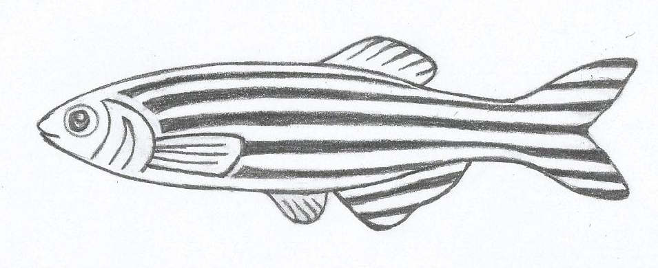
Hypothesis:
Experimental Cross #1
X

Slide 4
Hypothesis:
Experimental Cross #2
X

Slide 5
Observations and Results:
Was Your Hypothesis Correct?
Tank #1
Yes
No
Tank #2
Yes
No

Slide 6
Label the Parts of a Fish
Word Bank
Eye Fin Gills Mouth Nose Tail

